Slide 1
Music
Recommender
System
By Team-12

Slide 2
Areas of use
E-store
Search
Product
Delivery
Recomm.
Engines
Bills and mailers
Loyalty Programs
Email campaigns

Slide 3
What is a Recommender System?
Recommender systems are machine learning systems that help users discover new product and services. Every time you go online, a recommendation system is guiding you towards the most likely choice you might make.
Recommender systems are an essential feature in our digital world, as users are often overwhelmed by choice and need help finding what they're looking for. This leads to happier customers and, of course, more sales. Recommender systems are like salesmen who know, based on your history and preferences, what you like.

Slide 4
Approaches in Recommender System
1.)
Collaborative Filtering
2.)
Content Based Recommender Systems
3.)
Knowledge-Based
4.)
Demographic Recommender Systems

Slide 5
Limitations in Recommender System
Data sparsity
In practice, many commercial recommender systems are based on large datasets. As a result, the user-item matrix used for collaborative filtering could be extremely large and sparse, which brings about the challenges in the performances of the recommendation
1.)
2.)
Scalability
As the numbers of users and items grow, traditional CF algorithms will suffer serious scalability problems
3.)
Cold start Problem
The cold start problem is a typical problem in recommendation systems. The “cold start" problem happens in recommendation systems due to the lack of information, on users or items.

Slide 6
Project objective
Music Recommender System
To build a ML model which recommend personalized music to it’s user.

Slide 7
Components in Music Recommender
1.)
Item Profiling
2.)
User Profiling
3.)
Match Algorithms

Slide 8
Content Based Recommender System
Here, main idea is to recommend item to customer x, similar to previous item rated highly by x.
Examples:- Movies; same actor, director genre
People; recommend people with common friends.
Life cycle of content based recommender system is:
Step 1:- There is a user and let say he likes red circle and triangle.
Step 2:- Do the item profiling of the liked item for e.g. red, circle and triangle.
Step 3:- Upon the item profiling do the user profiling what type of thing user like and recommend the same type of items to the user.

Slide 9
Item profiling and User Profiling
Item Profiling:-
For each item we need to create the item profile.
Profile is a set of important features.
For text based features, to extract them we can use TF-IDF.
User Profiling:-
User has rated item with profile i₁,.......,i_{n}
It is the weighted average of rated item profile.
i₁+i₂...............+i_{n}
N
Normalize the weights using average rating of user.

Slide 10
Making Predictions
User profile x, item profile i.
Estimate U(x,i)=cosΘ=(x.i)/ ||x|| ||i||
θ
Smaller the θ, more similar the items.

Slide 11
Pros and Cons of content based recommender system
Pros:-
No need data of other users.
Able to recommend user with unique taste.
Able to recommend new and unpopular items.
Cons:-
Finding the appropriate feature is difficult.
Cold start problem for new user

Slide 12
Collaborative Filtering
Collaborative filtering is based on the fact that relationships exist between products and people’s interests.
Many recommendation systems use collaborative filtering to find these relationships and to give an accurate recommendation of an accurate recommendation of a product that the user might like or interested in
Collaborative filtering has basically two approaches:
User - based
Item - based

Slide 13
User - based :
User - based collaborative filtering is based on the user similarity or neighbourhood.
In this approach , we have an active user for whom the recommendation is aimed.
The collaborative filtering filtering engine first looks for users who are similar. That is users who share the active users rating patterns.
Collaborative filtering basis this similarity on things like history, preference, and choices that users make buying, watching or enjoying something.
Item - based :
Item based collaborative filtering is based on similarity among items .
In the item based approach, similar items build neighborhoods on the behavior of users.
Example, Item 1 and Item 3 are considered neighbors as they were positively rated by both User 1 and User 2. So, Item 1 can be recommended to User 3 as he has already shown interest in Item 3.

Slide 14
Pros and Cons of Collaborative filtering
Pros:-
Works for any kind of item, no feature selection needed
Cons:-
Cold Start Problem
Data Sparsity
First Rater
Popularity bias, tends to recommend popular items

Slide 15
The Cold Start Problem
What is cold start problem?
With recommendation engines, the “cold start” means that the circumstances are not optimal yet to provide the best possible results.
In e-Commerce, there are two categories of cold start:
Product cold start
User cold start

Slide 16
Product cold start:
The right target audience for an advertisement is best calculated by looking at the former visitors for the ad. According to assumption of collaborative filtering, if an ad was already popular with a certain group of people then others who fit in that groups profile are likely to respond well to that ad
Problem:
Recommendation systems that run on collaborative filtering recommend items based on users action. The more user actions the easier it is to tell which items the user can be interested in .
This however, brings major contradiction and difficulty. Even though newest ads are actually the most relevant ones, recommendation system is far less confident in recommending them to users than it has with older items.
Solution:
Content-based filtering is the method that have answer. Our system first uses meta-data of new products the creating recommendations, while visitor action is secondary for a certain period of time
Also, we can identify visitors who are only there to browse and those determined visitors who know what they are looking for.

Slide 17
User Cold Start
The user or visitor cold start simply means that a recommendation engine meets new visitor for first time, because there is no user history , the system doesn’t know the personal preferences of the user which is crucial in creating great experience for them.
Problem :
Visitors to your site will probably not register upon their first arrival. What’s more, classified ad sites usually don’t require visitors to log in . The users need to be identified by cookies.
If visitors delete or block cookies, they will be identified as new user each time they visit their favourite classified ads site. If this can’t be solved everything recommendation system learns about these users will be lost as spoon as they leave the site.
Similar phenomenon can happen with returning users and with users who use different devices.
Solution:
Recommendation systems have an efficient solution for user cold start problem.
By default, the very first step is to apply a popularity based strategy.
Nextstep, you can narrow selection of ads to display for visitors by using contextual information.
Geolocating users with either geoIP or their mobile devices GPS coordinates.
Behavioural information “kicks in” only 2-3 clicks during the users very first visit.

Slide 18
Exploratory Data Analysis:
Steps in Data Exploration and preprocessing:
Identification of variables and data types.
Analyzing the basic metrics.
Non-Graphical Univariate Analysis.
Graphical Univariate Analysis.
Bivariate Analysis.
Variable transformations.
Missing value treatment.
Outlier treatment.
Correlation Analysis.
Dimensionality Reduction.
EDA: https://colab.research.google.com/drive/1OV3Mn2yMMYHiXGGmChv3BJsQMx7kAtQh?usp=sharing#scrollTo=yZyg4AT8jkDb

Slide 19
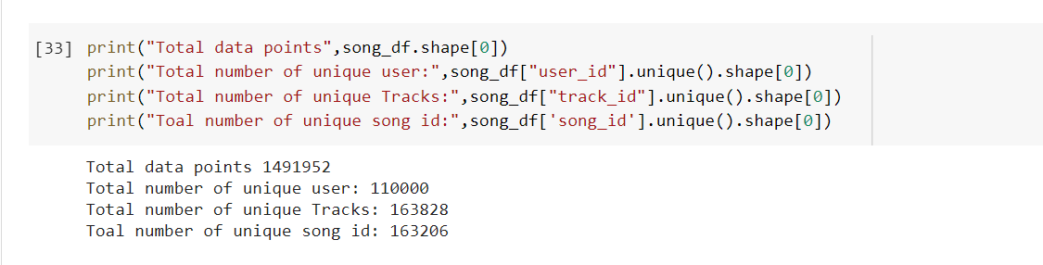
Non Graphical Analysis:
Total number of data points are 1491952
Total number of unique users: 110000
Total number of unique tracks: 163828
Total number of unique song id: 163206

Slide 20
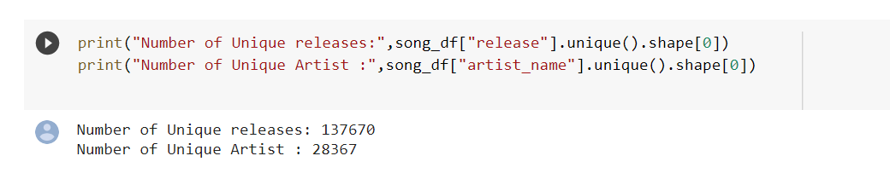
Number of unique releases: 137670
Number of unique artist: 28367

Slide 21
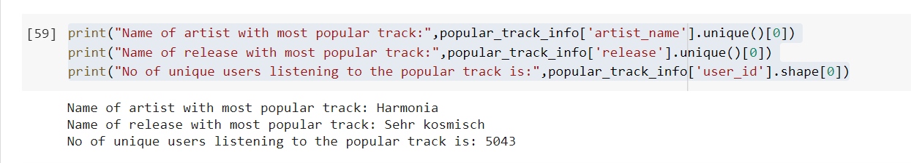
Name of artist with most popular track is: Harmonia
Name of release with most popular track is: Sehr Kosmisch
No. of unique users listening to the popular track is: 5043

Slide 22
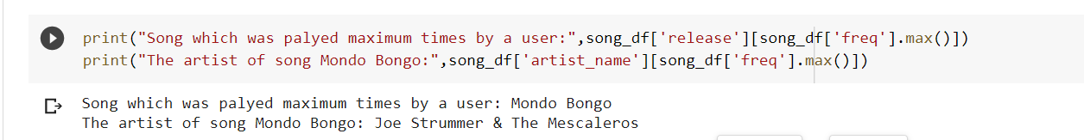
Song which was played maximum times by a user: Mondo Bongo
The artist of song Mondo Bongo: Joe Strummer & The Mescaleros

Slide 23
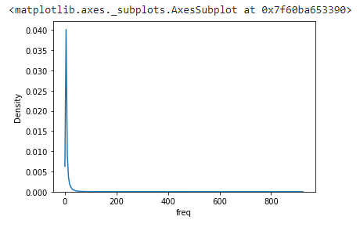
Visualization:
Frequency distribution of dataset
Play count of most of the song is close to 1.

Slide 24
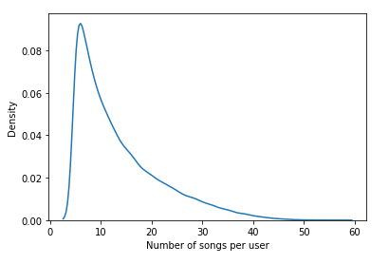
Distribution plot for number of songs per user
No. of songs per user is between 3 and 7

Slide 25
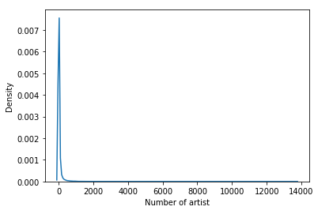
Distribution plot for number of artists
Only very few artists are very popular
Around 250-350 artist are very popular out of 28367 artist

Slide 26
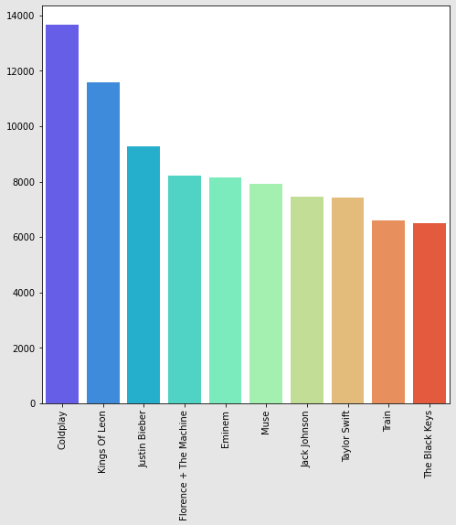
Top 10 Artist

Slide 27
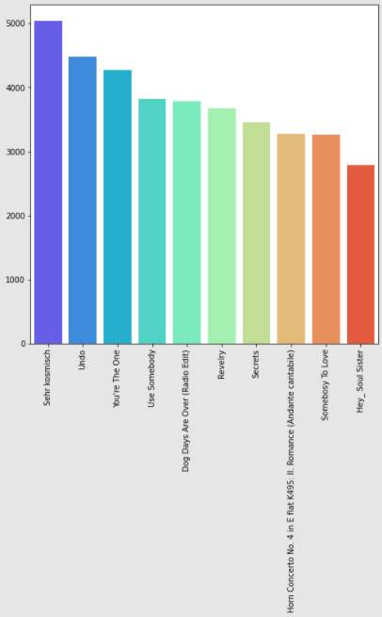
Top 10 songs

Slide 28
Exploratory Data Analysis Conclusions:
The following are the conclusions made from the observations through EDA:
The play count in most of the cases in close to 2.
No of songs for a particular user are between 3 and 7.
Maximum no. of songs for a particular user are 57.
On an average, the user listens to 13 songs and minimum of 5 songs.
The artist ‘Coldplay’ has maximum plays.
The song ‘Sehr Kosmisch’ is most played song.
There are 28367 Number of unique Artists.
There are 110000 users.
There are 137670 unique songs (releases).
Maximum time any song has been played by a user is 923.
The song which has been played maximum times by a user is ‘Mondo Bongo’
The artist of song Mongo Bongo: Joe Strummer & The Mescaleros.

Slide 29
Modelling Techniques
Collaborative
Content Based
Popularity Based

Slide 30
Collaborative Based
Collaborative Filters work with an interaction matrix, also called rating matrix. The aim of this algorithm is to learn a function that can predict if a user will benefit from an item - meaning the user will likely buy, listen to, watch this item.
Among collaborative-based systems, we can encounter two types: user-item filtering and item-item filtering.
We'll go through the steps for generating a music recommender system. This time, we are going to use a matrix factorization approach

Slide 31
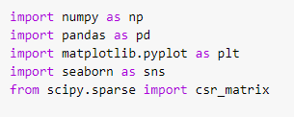
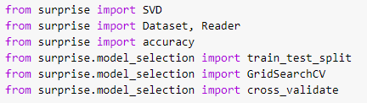
Implementation:
We first import required libraries, modules and packages which includes libraries like numpy, pandas, matplotlib, seaborn, scipy and scikit .

Slide 32
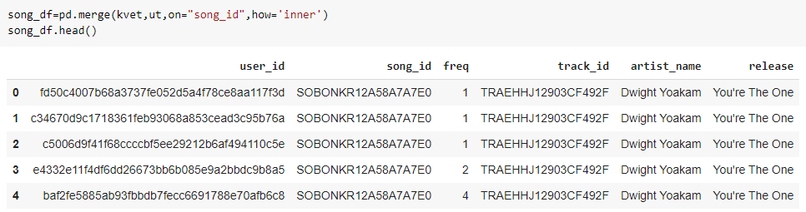
Preparing Data:

Slide 33
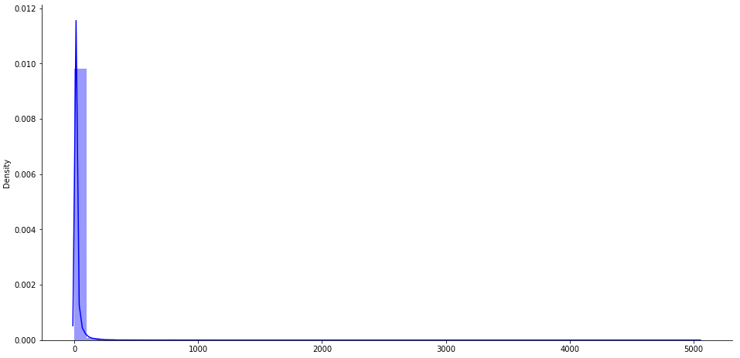
Before modeling we need to find how many times a user listen to the same song on average.
Distance plot between songs and users

Slide 34
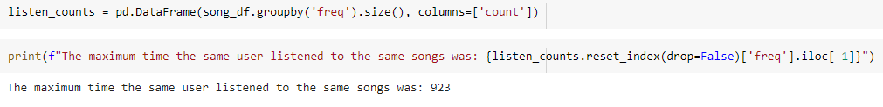
A song is listened for an average of 8.924702523191549 users, with minimum 1 and maximum 5043 users
The maximum time the same user listened to the same songs was: 923

Slide 35
Model and recommendations
Matrix Factorization is a powerful way to implement a recommendation system. The idea behind it is to represent users and items in a lower-dimensional latent space.
So, in other words, Matrix factorization methods decompose the original sparse user-item matrix into lower dimensionality less sparse rectangular matrices with latent features.
This does not only solve the sparsity issue but also makes the method scalable. It doesn't matter how big the matrix is, you can always find lower dimensionality matrices that are a true representation of the original one.
Among the different matrix factorization techniques, we found the popular singular value decomposition (SVD).
This can be an abstract concept as we deepen into the mathematical foundations. But we'll try to keep it as simple as possible. Imagine we have a matrix A that contains the data for n users x m songs. This matrix can be decomposed uniquely into 3 matrices; let's called them U, S, and V.
In terms of our song recommender:
U is an n users x r user-latent feature matrix V is an m songs x r song-latent feature matrix S is an r x r non-negative diagonal matrix containing the singular values of the original matrix. Instead of working with the implicit rating as it is, we'll apply the binning technique.

Slide 36
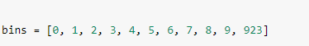
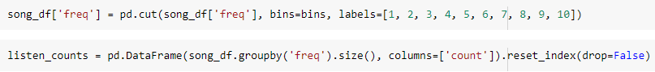
We'll define 10 categories. The original data values which fall into the interval from 0 to 1, will be replaced by the representative rating of 1; if they fall into the interval 1 to 2, they will be replaced by 2; and so on and so forth. The last category will be assigned to original values ranging from 9 to 923.
Now we consider the frequency of song played.

Slide 37
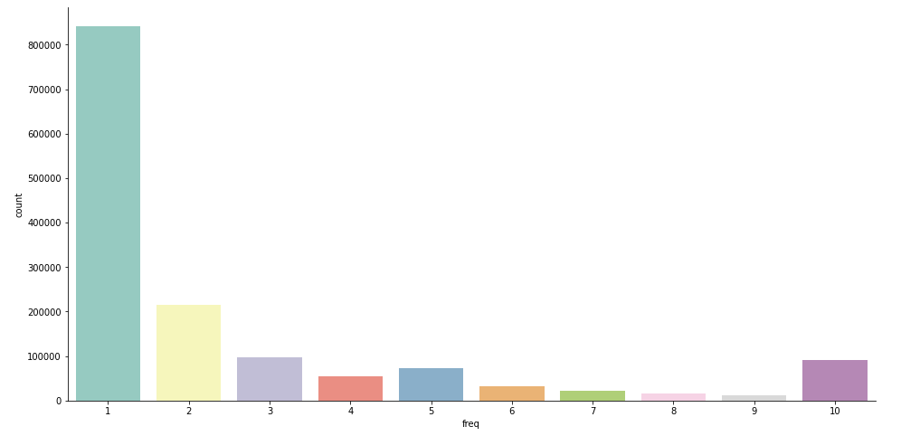
The above plot depicts the frequency count of songs listened .

Slide 38
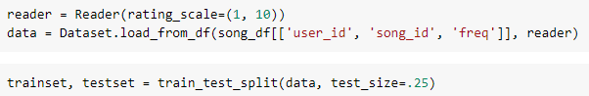
we are going to use a fun package called surprise. Surprise is an easy-to-use Python library specially designed for recommender systems.
To load a dataset from our DataFrame, we will use the load_from_df() method.
We will need to pass the following parameters:
df: The dataframe containing the ratings. It must have three columns, corresponding to the user ids, the song ids, and the ratings. reader (Reader): A reader to read the file. Only the rating_scale field needs to be specified.

Slide 39
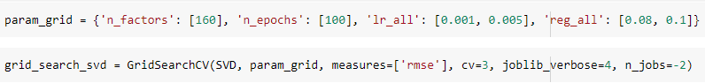
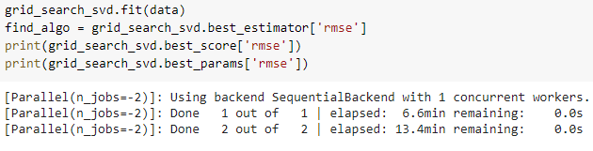
We'll use the built-in function for SVD. First, a set of parameters is going to be defined to search for the best parameters for the model.
The GridSearchCV class will compute accuracy metrics for the SVD algorithm on the combinations of parameters selected, over a cross-validation procedure. This is useful for finding the best set of parameters for a prediction algorithm.
finding the best parameters for the model

Slide 40
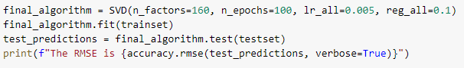
Perform the cross validation
After finding the best parameters for the model, we create our final model, train it and find the error for the test set.

Slide 41
Further Improvements :
There are many songs that are played (listened) only once, We can further improve this model by adding some threshold where rating 1 starts from the song which is played at least 15-16 times.

Slide 42
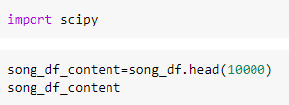
Content Based
In this recommender system the content of the songs is used to find its similarity with other songs. Then the songs that are most likely to be similar are recommended.
Implementation:
Importing important Libraries and modules

Slide 43
What is TF-IDF?
The full form is term frequency and inverse document frequency. we multiply the TF and IDF to convert out sentence to vector.
TF=No. of repetition of words in sentence/ No. of words in sentence
From this formula it calculates the term frequency.
IDF= log(NO. of sentences/No.of sentences containing the words)
After getting the both values we multiply the TF and IDF.After multiplying we will get the frequency of words with respect to importance of words. Here we get different values for each word.
we have removed the duplicate releases, to make sure our recommendations to be unique and different releases.

Slide 44
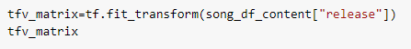
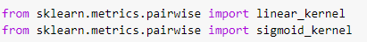
We have applied the TF-IDF on release feature of dataset.
we have got our Sparse matrix with shape (10000,2459)
Importing linear kernel and sigmoid kernel to perform cosine similarity.

Slide 45
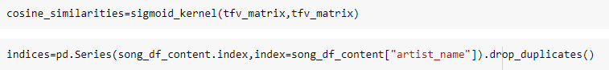
What is cosine similarity?
Here we compute the angle between two vectors drawn from origin to towards the two points. cosine similarity is the angle between the two points. Smaller the theta more close the points, means more similar.
cosine distance =1-cosine similarity
cosine similarity=cos(theta)
theta is angle between two vectors.

Slide 46
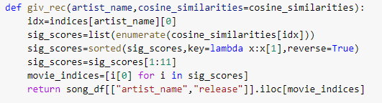
we have built the function to get the input from user and recommend the different release from our recommendation engine.

Slide 47
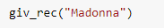
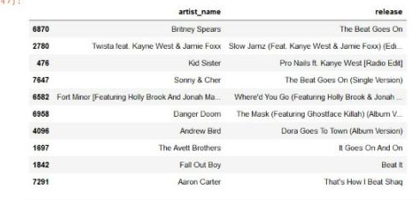
Observation:
We can see if the person listens to Beat Goes On [Featuring Kanye West] (Album Version) then it will suggest the beat goes on from britney Spears and so on..

Slide 48
Popularity Based:
As the name suggests Popularity based recommendation system works with the trend. It basically uses the items which are in trend right now. For example, if any product which is usually bought by every new user then there are chances that it may suggest that item to the user who just signed up.
In our project using popularity based recommender system, we will predict which songs has been hears by maximum users i.e most popular songs and will predict them to the users.

Slide 49
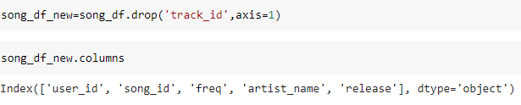
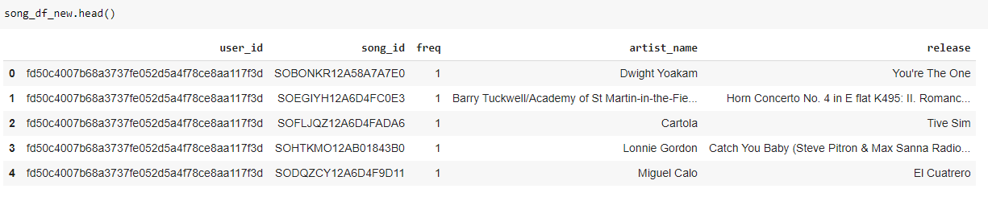
Data preparation:
Dropping the track_id and creating the new data frame song_df_new, Dropping the track_id and creating the new dataframe song_df_new.
New Data frame song_df_new has 1450933 rows and 5 columns.

Slide 50
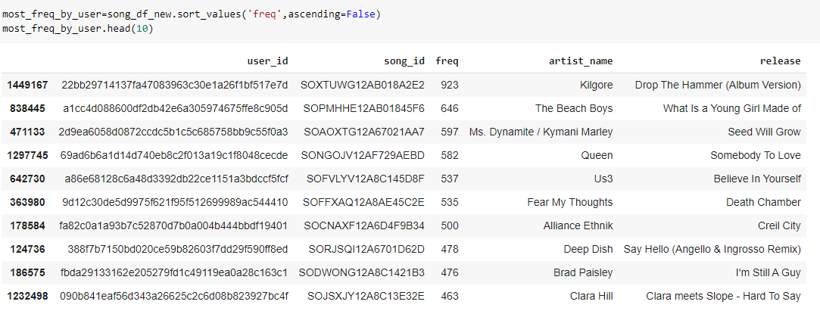
Implementation:
Finding the maximum frequency of a song played by individual users.

Slide 51
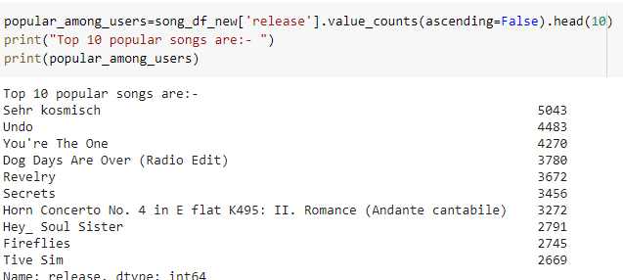
These are the top 10 most popular songs which are played by most of the users and we can recommend them to other users.

Slide 52
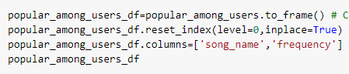
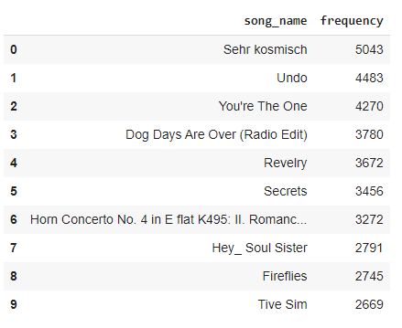
Creating the data frame of these 10 most popular songs
New Data frame

Slide 53
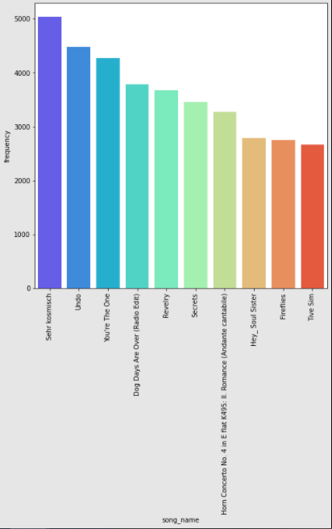
Observations:
Top 10 popular songs

Slide 54



Problem in hand
Hybrid model
To make a personalized music recommendation we go by all the traditional approaches and the then we will club all the predictions made by the models and submodels and define a function which gets the best fit out of those predictions.

Slide 55
Project Flow
04
Popularity Based Recommendation System
Hybrid model Recommendation System
01
03
Collaborative Filtering Based Recommendation System
Content Based Recommendation System
02

Slide 56
Project timeline
JUNE 12
JUNE 13
JUNE 14
JUNE 16
JUNE 17
JUNE 18
JUNE 20
Exploratory Data Analysis
PPT for EDA Conclusions
Data Preparation.
Popularity Based Recommendation System Implementation
Collaborative Filtering Based Recommendation System Implementation
Content Based Recommendation System Implementation
Hybrid model Recommendation System Implementation

Slide 57
References
https://www.ijltet.org/wp-content/uploads/2014/10/21.pdf
https://techtalkwithbhatt.com/2019/05/02/what-is-a-recommender-system-and-what-are-its-types/
https://builtin.com/data-science/recommender-systems
https://medium.com/@toprak.mhmt/collaborative-filtering-3ceb89080ade
https://yuspify.com/blog/cold-start-problem-recommender-systems/

Slide 58

Thank you!

